Slide 1
Artificial Intelligence in Education: A Boon or Bane
After this presentation, you will learn
What is AI
Areas of Applications
Types of AI
AI and other related terms
Applications of AI in Education
Benefits and disadvantages

Slide 2
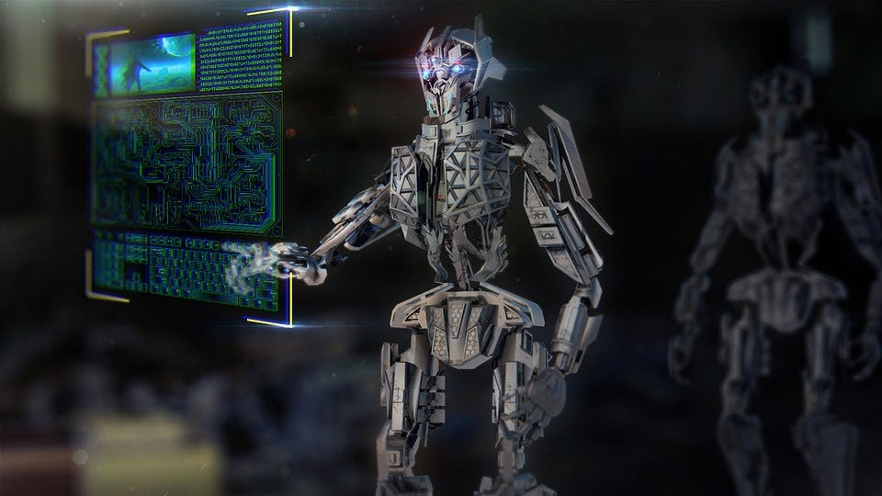
Machine can think , reason , learn and act intelligently just like Intelligent Human Being.
Artificial Intelligence: Computer generated higher order cognitive process application as expert system, natural language processing, speech recognition and machine vision

Slide 3
Application Context of AI
Strategic system & Chess
Web Search Engines
Automated Decision making Recommended AI USE Systems
Understanding Human Speech
Generative & Creative tools (Siri & Alexa)
(ChatGpt & AI art)
Self Driving Car
(waymo)

Slide 4
Types of AI
TYPE-1: Reactive AI: Having No memory, and only Task based. Example, Deep Blue which has defeated Garry Kasparov
TYPE-2: Imitated Memory: They can use past memory to inform future decision. Example, self-Driving Car
TYPE-3: Theory of Mind: This has social intelligence to understand emotions, infer human emotions, predict behaviour
TYPE-4: Self-Awareness: Having a sense of self which gives them consciousness. This type of AI does not exist yet.

Slide 5
AI-Machine Learning and Deep Learning
Though used interchangeably by Companies.
AI: Coined in 1950 refers to Stimulation of Human Intelligence by Machine. Ever changing capabilites as New Technologies Developed. AI includes both Machine and Deep Learning
Machine Learning uses software to predict more accurately about outcomes without being explicitly programmed to do so.
Machine learning algorithms use historical data as input to predict New Output.
Deep Learning is a subset of Machine learning based on understanding of how the Brain is structured. It uses artificial Neural networks structure. Example: Self-Driving cars and ChatGpt

Slide 6
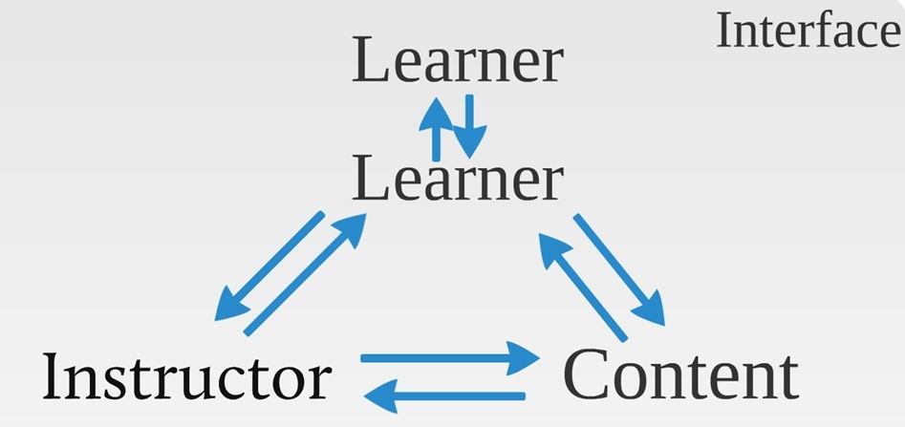
Interaction Level and Context
Student-content interactions
Curriculum pathways
Pace of learning
Location of learning
Student-student interactions
Asynchronous and just in time
Student-faculty interactions
Asynchronous, whenever, wherever
Informed by student performance (learning analytics)
Student-institution interactions
Alerts, nudges, advising to guide learning

Slide 7
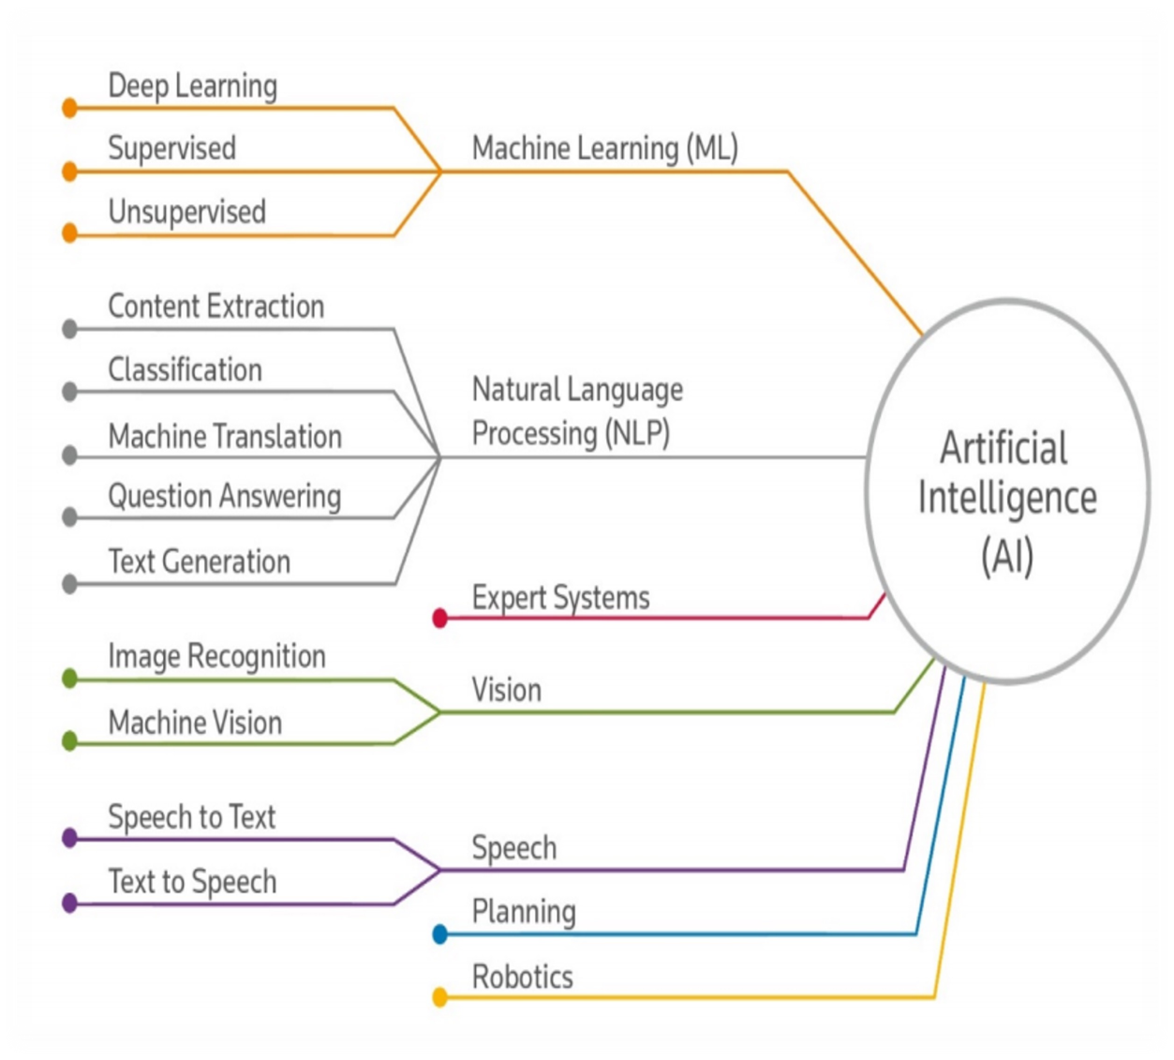
Chat Gpt and AI Art

Slide 8
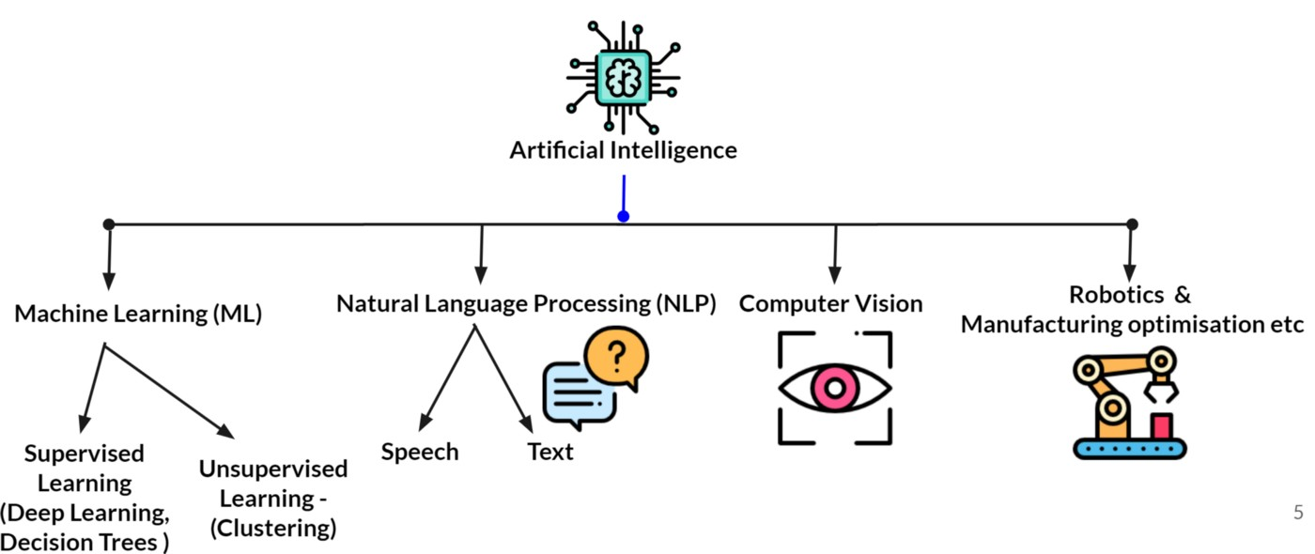

Slide 9
AI Software and Language Learning
Personalized Language Materials and Resources: Duolingo, Memrise, Italki
AI Writing Assistants: Grammarly, Essaybot, Quillbot, AI Writer, Textio, etc
AI Chatbots: Mike, Elbot, Cleverbot, JohnLennon, Zabaware, and so on.
AI Language Learning Software: Duolingo, Busuu, Speexx, Babbel, Memrise, and so on.

Slide 10
Applications in Education
Smart Content: With the help of AI, the textbooks could be split into small chunks of digestible guides, which is easy to read and understand.
Personalized Learning: AI in education can adapt quickly to individual needs and deliver personalized learning methodologies and activities driven by the learners’ interests.
Adaptive Learning: Tracking their academic progress, modify the course or its learning pace
Data Accumulation: Using previous search queries, AI in education can suggest related content for the students.
Virtual Facilitator: Virtual Facilitator can think, act, and react to the students’ queries and act as an assistant for the teacher

Slide 11
Automated Grader:Robo-graders replace a part of the grading system, and human grader is always there for further assessment
Chat Campus / Chatbot: The chatbot collects the students’ opinion through a dialogue interface as if it is a real interviewer and look for reasons too for varied opinions
Proctoring: AI-powered systems ensure the authenticity of the student to take the exam and prevent from cheating.
Classroom/Behaviour Management: Real time Monitoring, Parent Communication, Personalised Feedback, Face recognition, Emotion recognition, Voice Analysis.Eg: ClassDojo, SkedPal, Teachmint

Slide 12
Continues….
Gamified Learning Engagement:NLP, Intelligent Tutoring, Automated Content Generation, Intelligent Game Design Eg: Blooket, Quizalise, Quizizz
Staff Scheduling & Management: Automated Scheduling, Skill Matching, Real-Time Updates, Workload Balancing, Compliance Monitoring, Integration with HR System
Transportation Maintenance: Predictive Maintenance, Automated Tasks, Decision Support, Remote Monitoring, IoT and Sensors
Cyber Safety & Security Management: Threat Detection, Anomaly Detection, Vulnerability Management, Security Analytics and Reporting

Slide 13
Context of Application In Higher Education
Ensure Originality of work : Used for checking Plagiarism of content or created works.
Application for Exam security: Facial Recognition, Proctoring, Content Monitoring, Biometrics, Data Analytics.
Application for student’s Enrollment and Retention: Chatbots Provides information about students stay on track, Personalised Guidance, Application Assistance, Notification, Reminder, Virtual Campus tours
Use for student’s learning Management System: Personalised Learning, Automated Assessment, Intelligent Reporting, NLP, Sentiment Analysis. Learning Analytics, Predictive Analysis
Use for Academic Research: Automated Literature Reviews, NLP, Machine Learning, Text generation, Computer Vision, Explainable AI, Ethical AI.

Slide 14
Continuation…..
Use for analyzing students success: Track Progress, Behavioral Analytics, Social Network Analysis, Adaptive Testing,
Use for Administration: Helping administrators to schedule courses and individuals to manage their daily, weekly, monthly or yearly schedules and progress.
Useful for Effective Management: AI is effective for monitoring the status of power supply, Wi-Fi and water services, alerting the facilities management workers when problems arise.
Overall Institution Management: AI is currently being used to manage entire schools, powering student records systems, transportation, IT, maintenance, scheduling, budgeting, etc.

Slide 15
Pedagogical Transformation….
Adaptive Learning: “Used to impart basic and advanced skills to students by assessing their present skill level and creating a guided instructional input and process which helps them become proficient.
Inclusive Development: AI can help special needs students access a more equitable education, for example by reading passages to a visually impaired student, helping both slow and advanced learners
Psychological Pedagogy: AI is currently used for application of interactive games during teaching which helps toddlers or infants to learn basic academic skills and more.
Pedagogical input and process Decision : AI is used by teachers and education administrators to analyze and interpret present teaching learning data to make better-informed decisions

Slide 16
Boon……
Good a detailed oriented Jobs: Diagnosis of certain cancers (Breast cancer and melanoma)
Reduced Time for Data heavy task: Used in heavy data needed sectors like- Banking, securities, Pharma, Finance services and Insurance
Saves Labour and Increases Productivity:
Deliver consistent Results:
Improve customer satisfaction through personalization
Virtual agents are always available
4 D’s of Robotization ( DULL, DANGERIOUS, DIRTY AND DEAR)
In Education: Individualized instruction (pace),Immediate feedback and scope for Corrective action

Slide 17
Bane….
Expensive
Required Deep Technical expertise
Limited supply of qualified workers to build AI tools
Eliminate Human Jobs, increases unemployment
Lack of ability to generalize one task to other
Human Resource Generated or drained…..

Slide 18
Thank you Partha Sarathi Mallik(Ph.D.) Professor and Head School of Education, Gangadhar Meher University, Odisha

